Slide 1
Predicting credit default risk to reduce financial losses
By Abigael Kariuki
February 2026

Slide 2

Outline
Business Problem
Stakeholders
Dataset
Exploratory Data Analysis (EDA)
Modelling
Limitations
Business Recommendations
Conclusions

Slide 3

Business problem
Banks and financial institutions face significant losses when customers default on credit payments.
The goal of this project is to predict the likelihood of default next month, allowing lenders to:
Reduce losses
Improve risk-based pricing
Intervene early with high-risk customers
We will build and evaluate models to predict default, using borrower demographics and credit behavior, with a focus on identifying defaulters.

Slide 4

Stakeholders
Primary stakeholders:
Credit risk and risk analytics teams in banks and financial institutions
Secondary stakeholders:
Product managers responsible for pricing and credit limits
Collections teams prioritising outreach of potential customers
Senior management monitoring portfolio risk

Slide 5

Dataset
The dataset used is the UCI Credit Card Default dataset, which contains 30,000 observations of credit card clients.
It includes:
Demographic information eg age, gender, education, etc
Credit limits
Historical outstanding debt amounts
Repayment behavior over six months
Whether the customer defaulted in the previous months and others

Slide 6
Variables
Target Variable
Default status
1 = Default
0 = No default
This is a binary classification problem.
Features (independent variables)
There are 25 total feature variables in our dataset.
All of them were used as predictors, excluding the unique identifier (`ID`). A few include:
-Credit limit (LIMIT_BAL)
-Demographic variables (AGE, EDUCATION, SEX, MARRIAGE)
-Repayment status history (PAY_0 to PAY_6)
-Monthly bill statement amounts (BILL_AMT1 to BILL_AMT6)
-Monthly payment amounts (PAY_AMT1 to PAY_AMT6)

Slide 7
Exploratory Data Analysis (EDA)

Slide 8
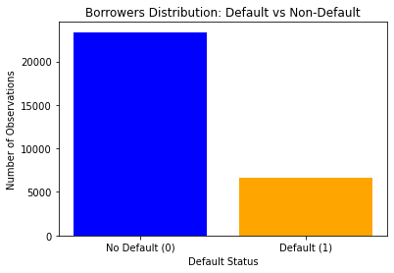
Distribution of borrowers: majority are non-defaulters, resulting in an imbalanced dataset
The dataset has 30,000 borrowers. The distribution of borrowers is as follows:
Non-defaulters: 23,364 (78%)
Defaulters: 6,636 (22%)
This shows the dataset is highly imbalanced, with non-defaulters making up the majority.
This creates a challenge for the model, as it may favor predicting non-defaulters.
To address this, class weights are applied in the modelling to prioritize detecting defaulters and reduce false negatives (i.e., borrowers who default but are predicted as non defaulters).

Slide 9
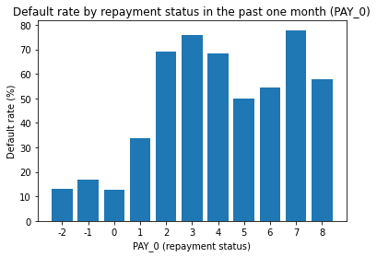
Credit default rate by repayment status: it increases significantly as repayment delays become more severe
Borrowers with recent loan payments (status 0) have default rates below 10%.
Borrowers with recent payment delays (e.g., status 6 and above) show sharply higher default probabilities.
Severe delays (status 6 and above) show default rates above 50–70%.
Therefore, recent payment delays (delinquency) are a strong indicator of future loan defaults

Slide 10
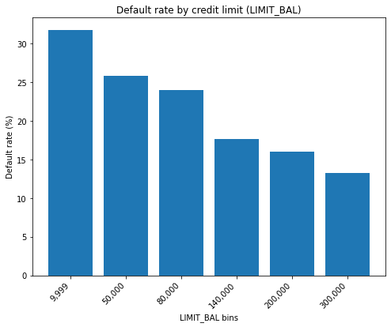
Credit default rate by credit limit: higher limits are associated with lower default risk
Borrowers with higher credit limits tend to have lower default rates
Those with lower credit limits tend to default more frequently, signaling that borrowers with lower financial capacity are more likely to default.
Credit capacity is a key indicator of financial stability, with higher credit limits correlating to a lower likelihood of default.

Slide 11
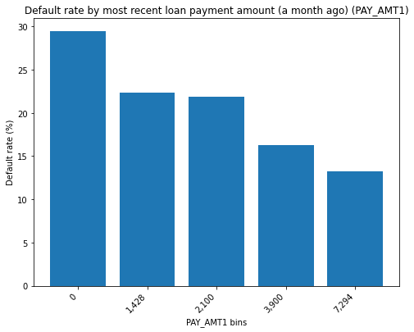
Credit default rate by recent loan payment amount: default risk decreases as payment amounts increase
Borrowers making smaller recent payments show higher default rates.
As recent payment amounts increase, default risk steadily declines.
Customers making larger payments demonstrate stronger repayment capacity.
Repayment capacity is therefore an important indicator of credit stability.

Slide 12
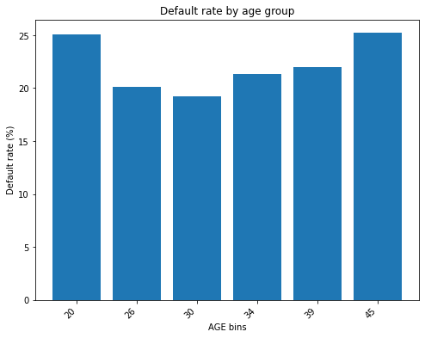
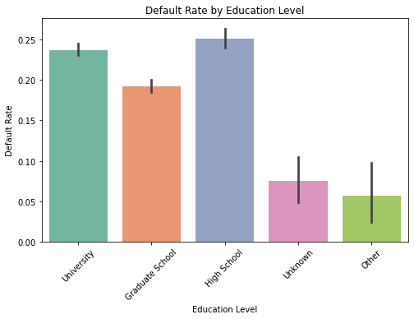
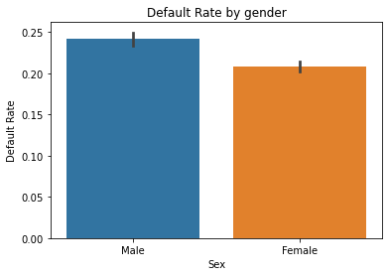
Credit default rate by borrower characteristics: demographic factors show limited variation in default risk
Default rates vary slightly across age, gender, education, and marital status.
Differences between demographic groups are not substantial.
No strong pattern suggests that demographics alone drive default risk.
Behavioral factors (repayment history and payment behavior) remain more influential predictors of default.

Slide 13
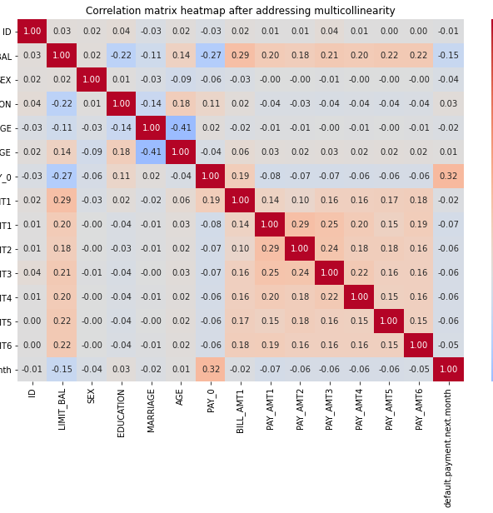
Addressing multicollinearity
A multicollinearity check revealed strong correlations between several variables, particularly those linked to their past values.
Highly correlated variables included:
Repayment status: PAY_2–PAY_6
Bill amounts: BILL_AMT2–BILL_AMT6
To reduce multicollinearity, we retained:
PAY_0 (most recent repayment status)
BILL_AMT1 (most recent bill amount)
After removing redundant variables, 14 features were used in the modeling process.
This reduction in collinearity enhances model stability and interpretability

Slide 14
Modelling
Objective: Predict the probability of a borrower defaulting.
Did four models:
Logistic regression
Logistic regression with class weights (balanced)
Decision tree
Decision tree with class weights (balanced)

Slide 15

Stakeholders
Primary stakeholders:
Credit risk and risk analytics teams in banks and financial institutions
Secondary stakeholders:
Product managers responsible for pricing and credit limits
Collections teams prioritising outreach of potential customers
Senior management monitoring portfolio risk

